Slide 1
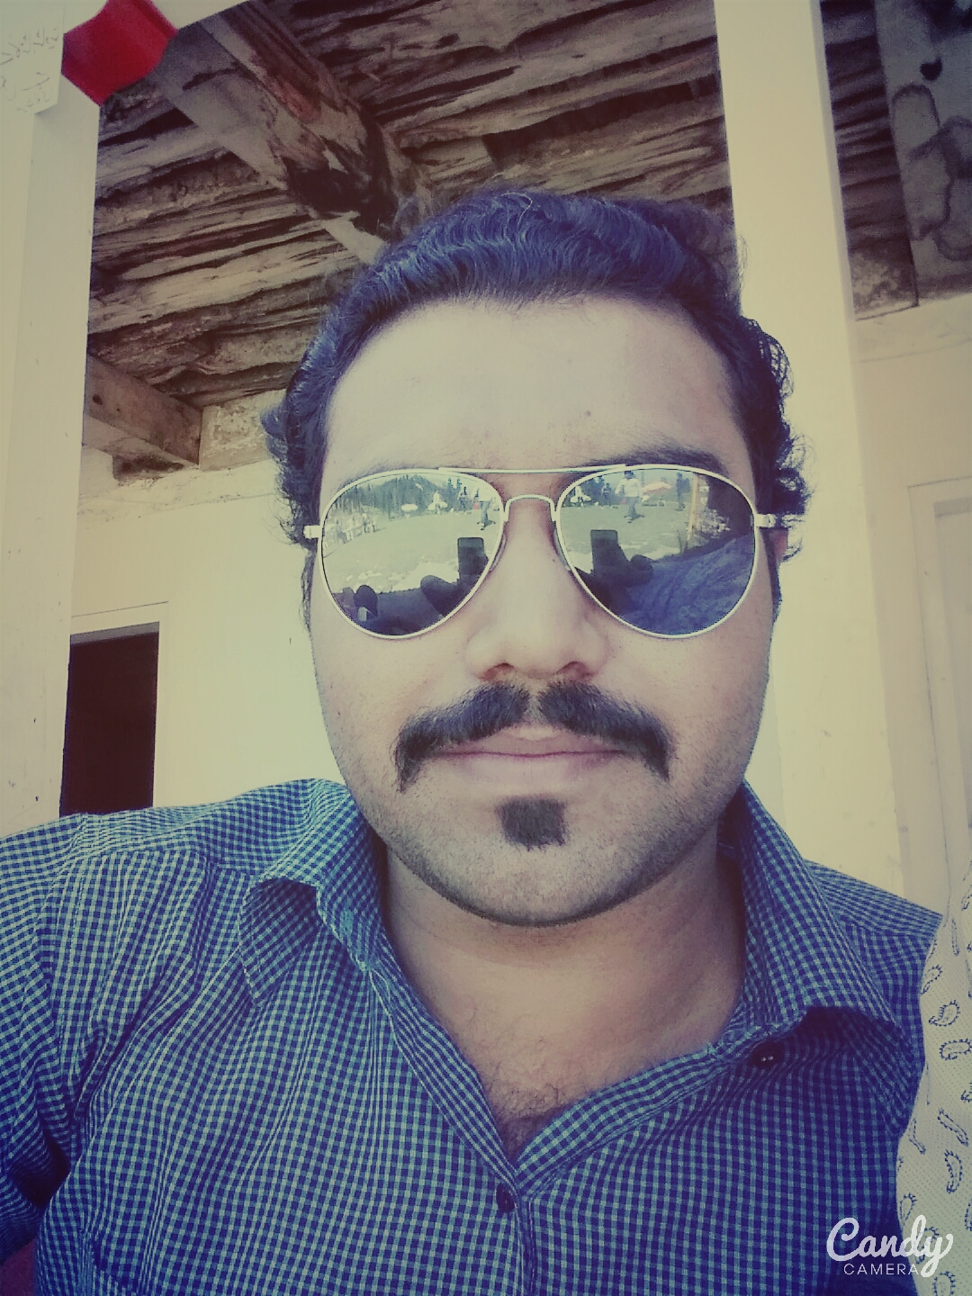
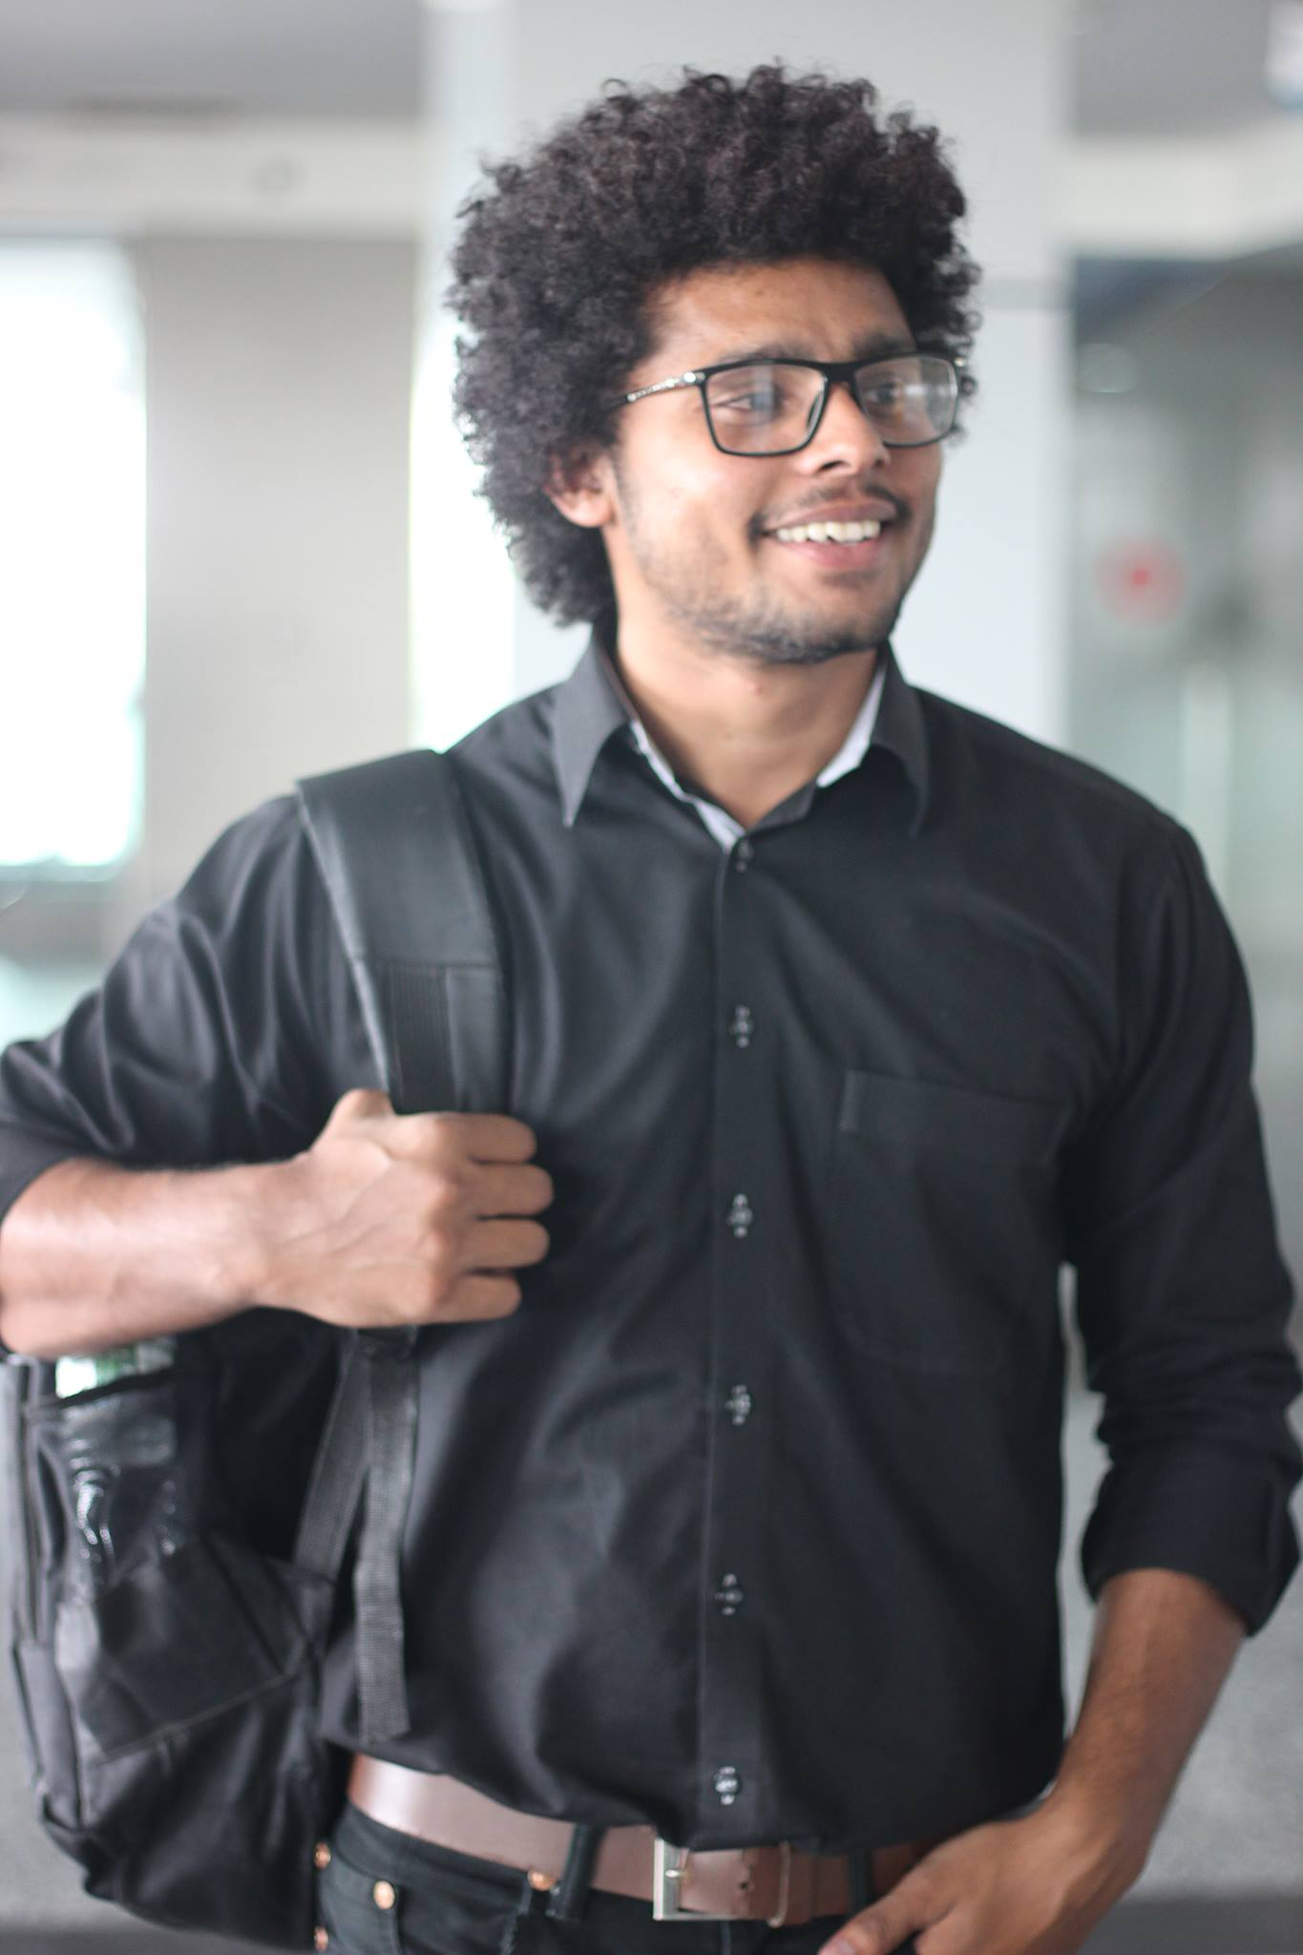
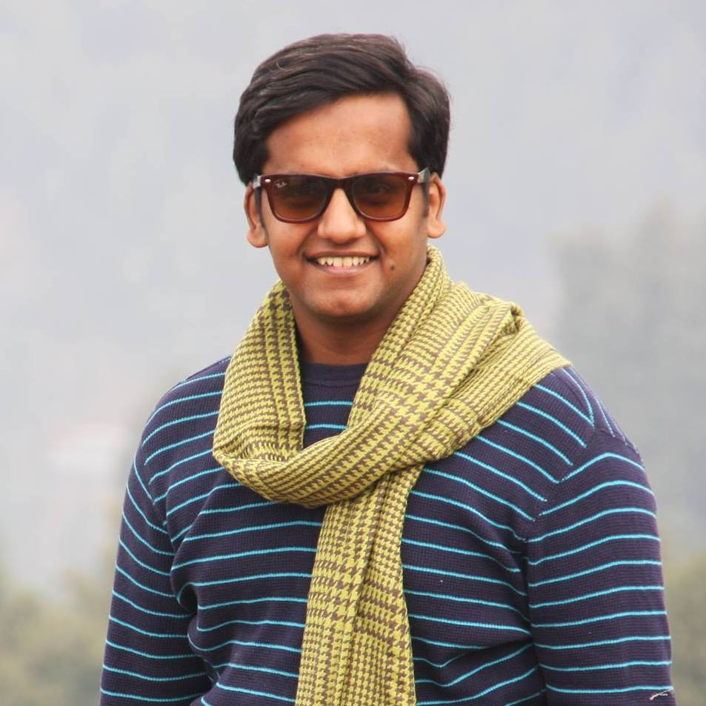
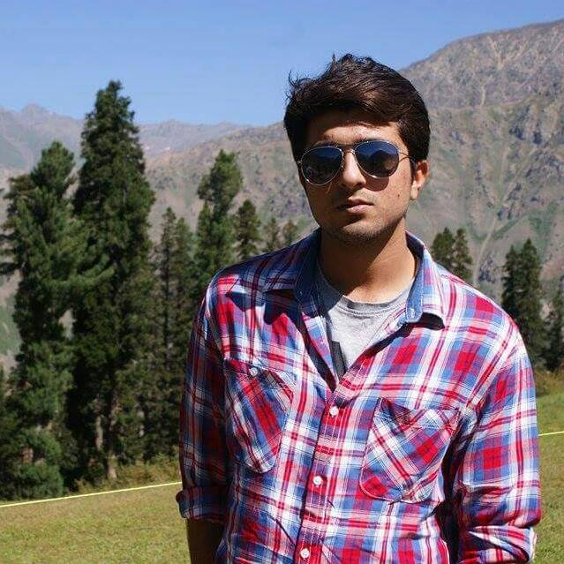
Ahmad Yousaf
Faisal Noor
Concept
Video
Team DastiCraft
Saqib Javaid
Raymond Luong

Slide 2
Dasti-Craft
Value Proposition
Problem:-People face difficulty while searching for shops of handicrafts. Sometime people are not able to find artisans who can deliver customize products.
Solution:- we are making a platform to solve such problems where people will be able to find all type of handicrafts and they will be able to order the customize products.

Slide 3
SIMPLE TASK
Hand made products can be bought easily from Dasticrafts.
Richard has to buy a birthday present for her friend. He orders a present from DastiCraft.

Slide 4
MODERATE TASK
People can find and buy any cultural handicraft from Dasticraft
Richard want to give her cultural gift but don’t know what to giver her so he search it on google and land on Dasticrafts, from where he orders a shawl and bangles for her friend.

Slide 5
COMPLEX TASK
Deliver the order at the door step easily.
Richard has come from Uganda, to study in ITU. He has a new friend Iqra. Iqra’s birthday is after a day and Richard don’t know any cultural gift but don’t know anything about the culture of Pakistan. He search on google to find anything cultural and landed on Dasticraft where he loved a shawl and bangles. He orders it and the order is delivered within two days. He handover it to Iqra and she loved it.

Slide 6
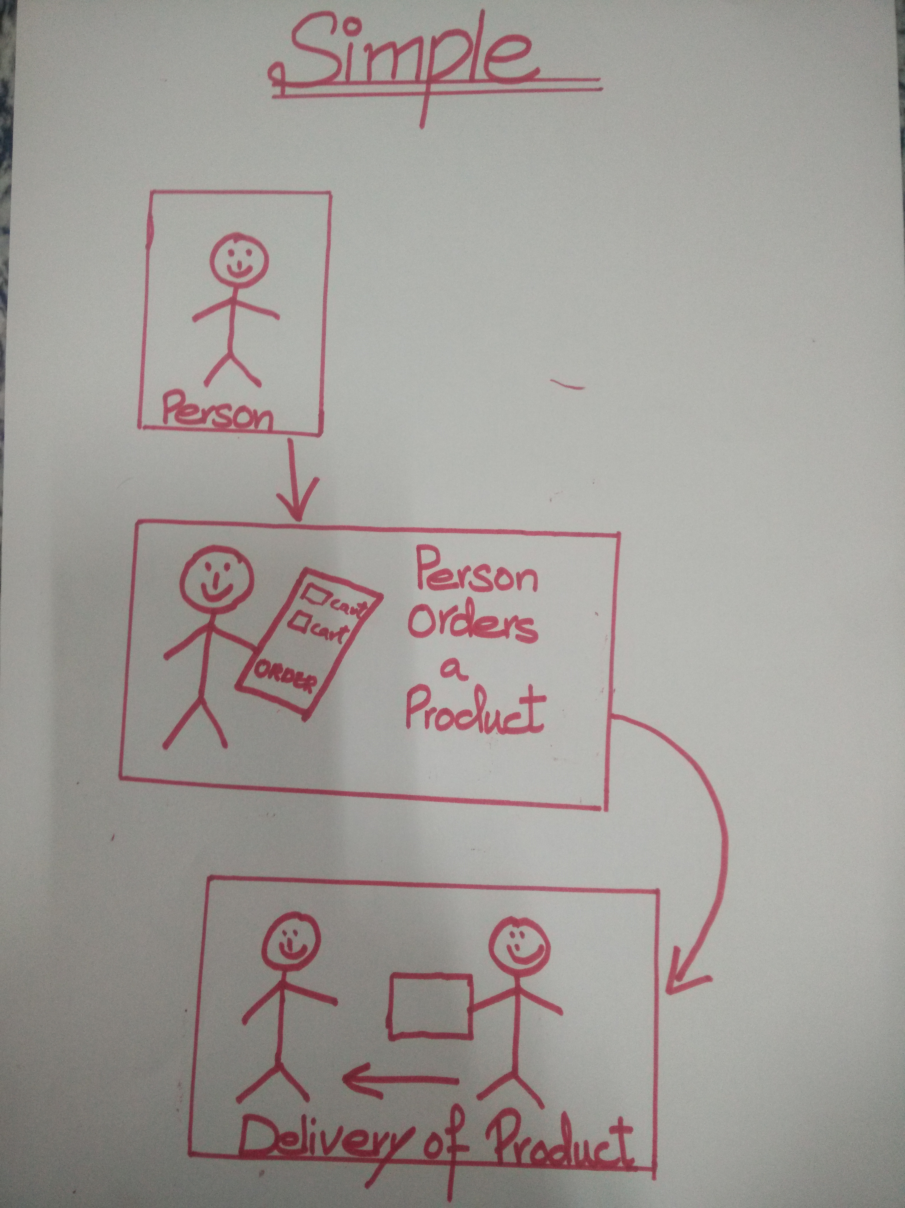
STORYBOARD
FOR SIMPLE TASK

Slide 7
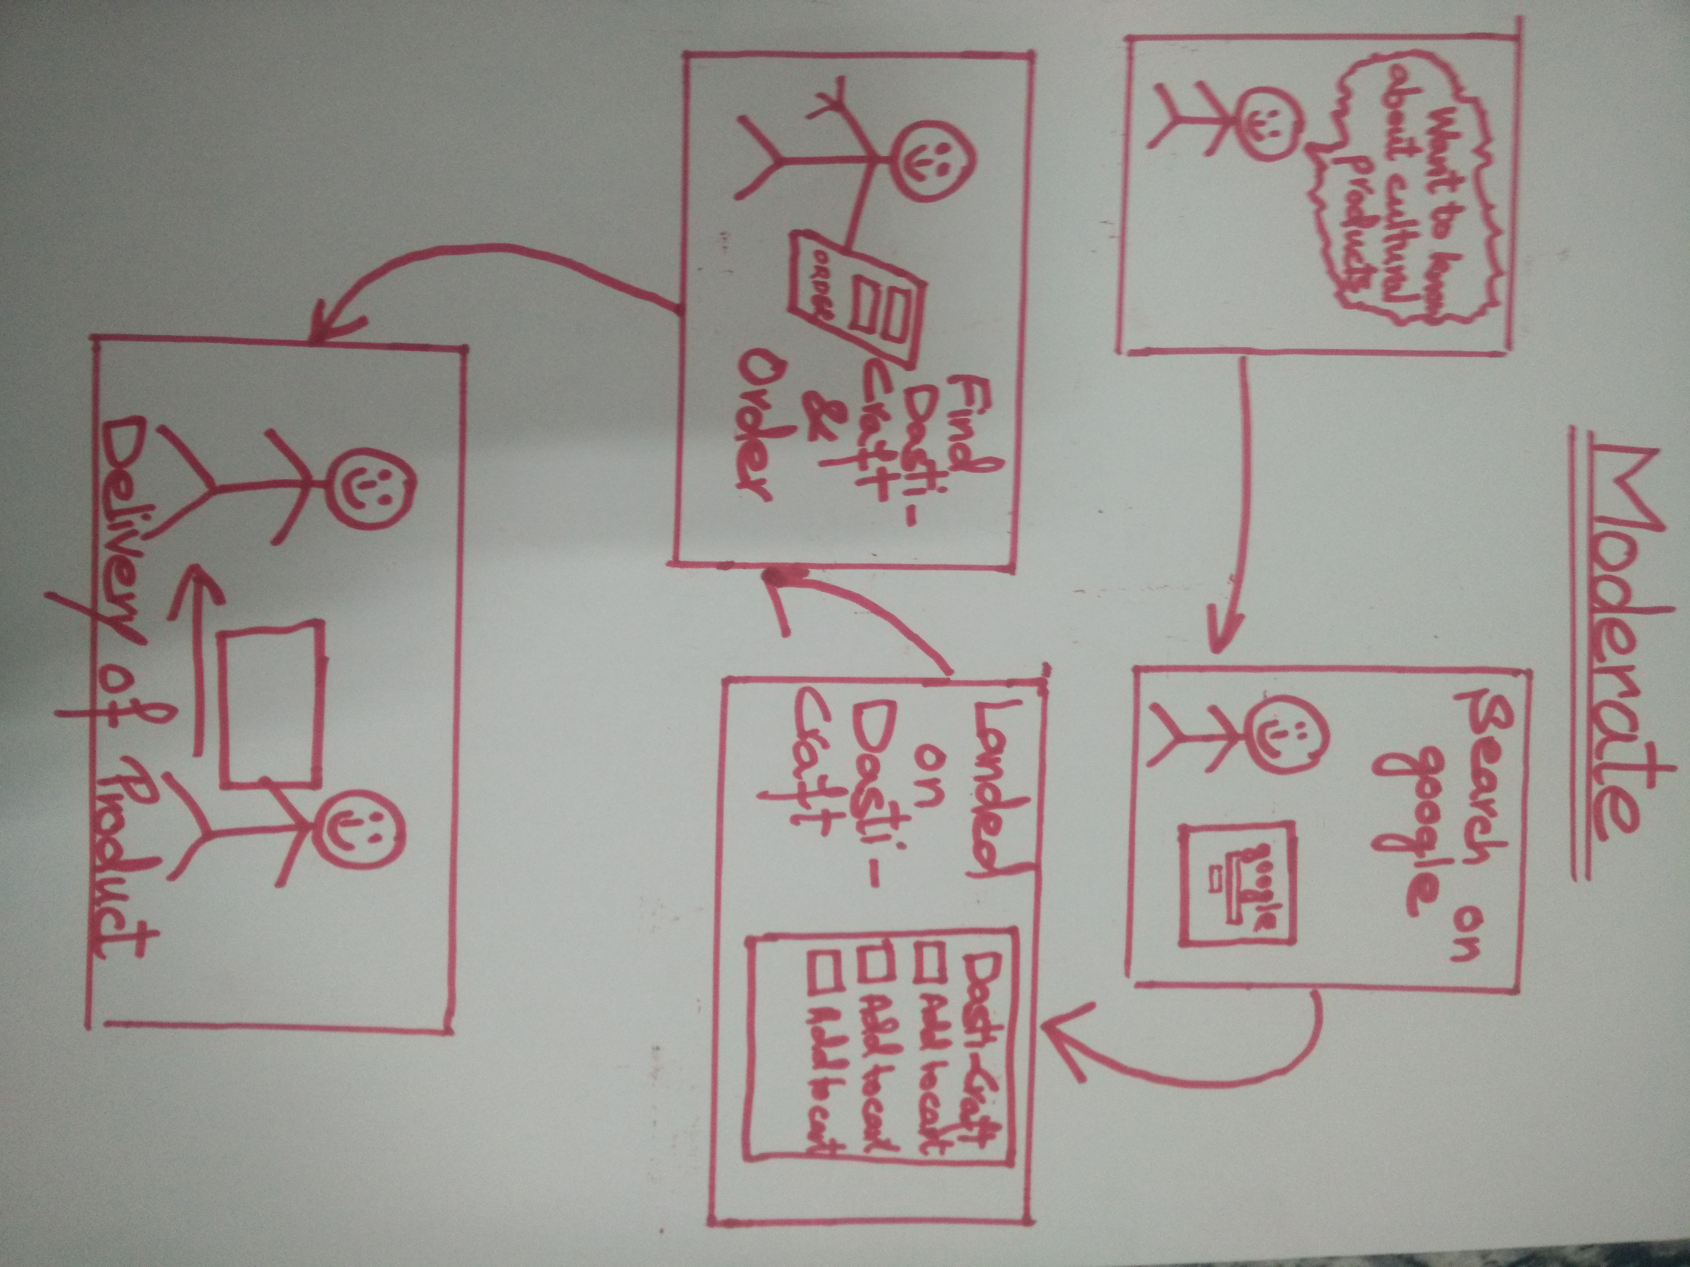
STORYBOARD FOR MODERATE TASK

Slide 8
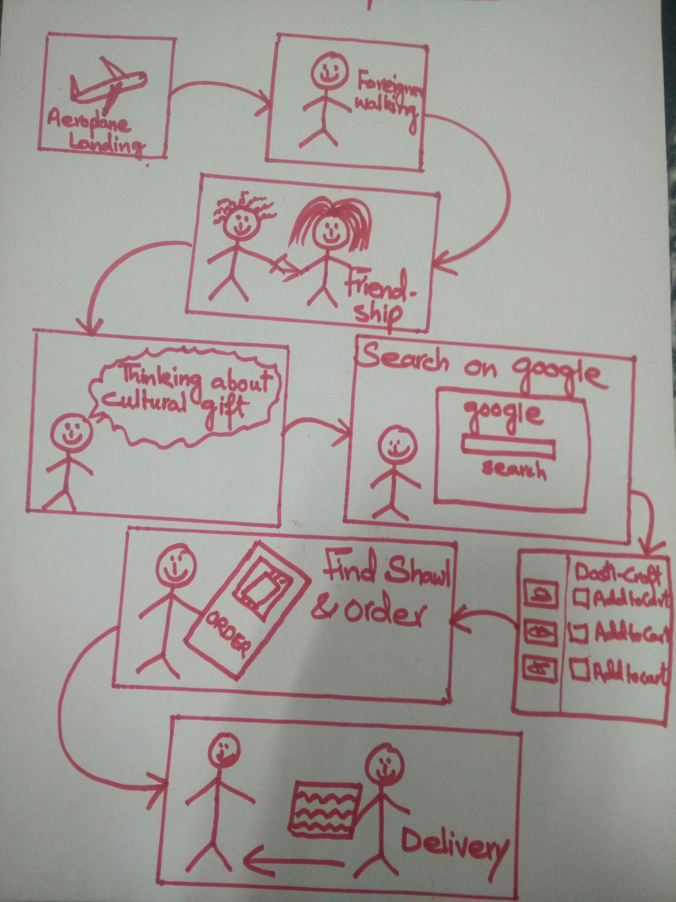
STORYBOARD FOR COMPLEX TASK

Slide 9
https://youtu.be/j7Ae6ywkxAg

